Slide 1

A CD of this message will be available (free of charge) immediately following today's message
This message will be available via podcast later this week at calvaryokc.com
2 Samuel
15-16

Slide 2
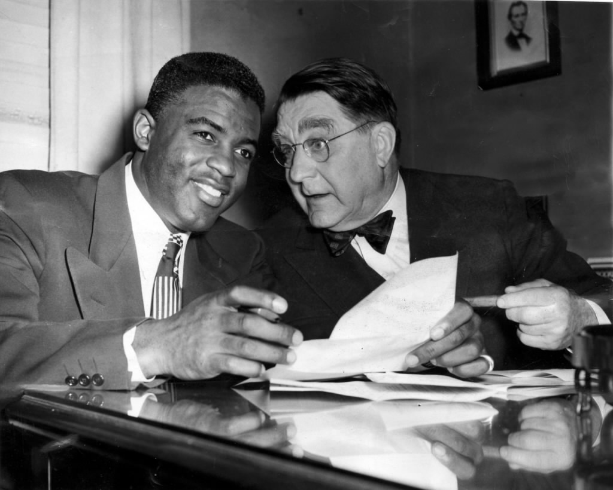
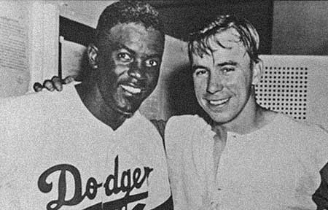
2 Samuel
15-16

Slide 3
2 Samuel
15-16
Cast of Characters
Mephibosheth ~ Jonathan's son
Ahithophel ~ David's counselor who defected to Absalom
Zadok and Abiathar ~ priests loyal to David
Hushai the Archite ~ David's counselor who remained loyal

Slide 4
2 Samuel
15-16

Slide 5
2 Samuel
15-16
Adam Clarke ~ "Absalom appeared to be the real and was the undisputed heir to the throne; David could not, in the course of nature, live very long; and most people are more disposed to hail the beams of the rising, than exult in those of the setting, sun.

Slide 6
2 Samuel
15-16

Slide 7
2 Samuel
15-16
David Guzik ~ "If someone objected Absalom would simply say, 'Tell me one specific thing that I have said or done.' In fact, Absalom could do all this and say, 'I'm helping David to deal with all this discontent' while Absalom was in fact promoting discontent."

Slide 8
2 Samuel
15-16

Slide 9
2 Samuel
15-16
Ps. 55:12–14 ~ ¹² For it is not an enemy who reproaches me;
Then I could bear it.
Nor is it one who hates me who has exalted himself against me;
Then I could hide from him.
¹³ But it was you, a man my equal,
My companion and my acquaintance.
¹⁴ We took sweet counsel together,
And walked to the house of God in the throng.

Slide 10
2 Samuel
15-16

Slide 11
2 Samuel
15-16
Warren Wiersbe ~ "Times of rebellion are times of revelation; you see what people really believe and where they stand."

Slide 12
2 Samuel
15-16

Slide 13
2 Samuel
15-16
Adam Clarke ~ "Behold a king, the greatest that ever lived, a profound politician, an able general, a brave soldier, a poet of the most sublime genius and character, a prophet of the Most High God, and the deliverer of his country, driven from his dominions by his own son, abandoned by his fickle people."

Slide 14
2 Samuel
15-16

Slide 15
2 Samuel
15-16
C. H. Spurgeon ~ "David could take this fellow’s head off and that in a moment, and yet he said, “Let him alone. Let him curse.” And this makes a splendid example. If you can revenge yourself, DON’T. If you could do it as easily as open your hand, keep it shut. If one bitter word could end the argument, ask for grace to spare that bitter word."

Slide 16
2 Samuel
15-16

Slide 17
2 Samuel
15-16
1 Pet. 2:21-23 ~ ²¹ For to this you were called, because Christ also suffered for us, leaving us an example, that you should follow His steps:
²²"Who committed no sin,
Nor was deceit found in His mouth";
²³ who, when He was reviled, did not revile in return; when He suffered, He did not threaten, but committed Himself to Him who judges righteously;

Slide 18
2 Samuel
15-16

Slide 19
2 Samuel
15-16
2 Sam. 12:11 ~ Thus says the Lord: "Behold, I will raise up adversity against you from your own house; and I will take your wives before your eyes and give them to your neighbor, and he shall lie with your wives in the sight of this sun."

Slide 20
2 Samuel
15-16

